Slide 1

A Reactive Online Optimization Based Whole Body Control for Quadruped Locomotion Over Challenging Terrain
[CE554] Mechanical Design of Civil Robot
Team 2
20185570 - Hong Seung woo
20183633 – Choe JongHun
October 5, 2018
Notes:
첫 페이지

Slide 2
Table of Contents
Background Explanation
Research Topic
Research Plan
Future Work
Notes:
목차

Slide 3
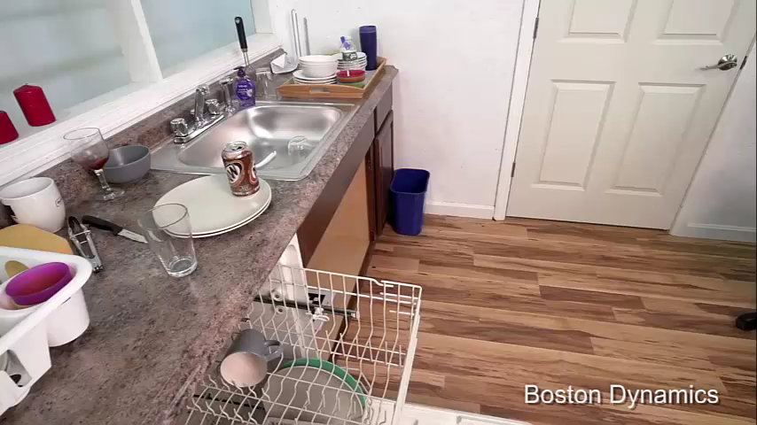
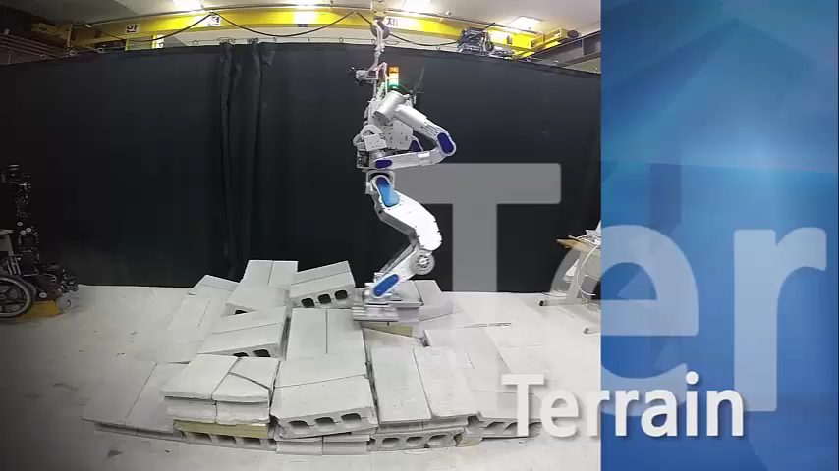
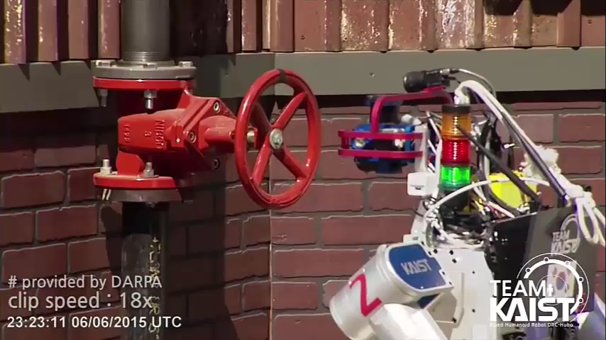
1. Background Explanation
Applications of (Legged) Robot
- Personal service
- Disaster relief
- Extra..
Big themes of “Civil Robotics”
Notes:
다음과 같은 다족 로봇의 응용이 있다.

Slide 4
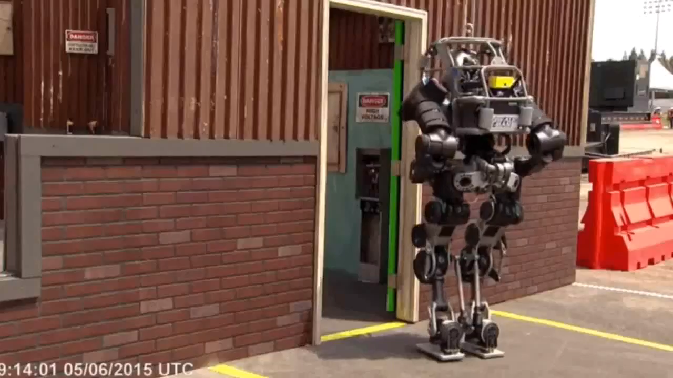
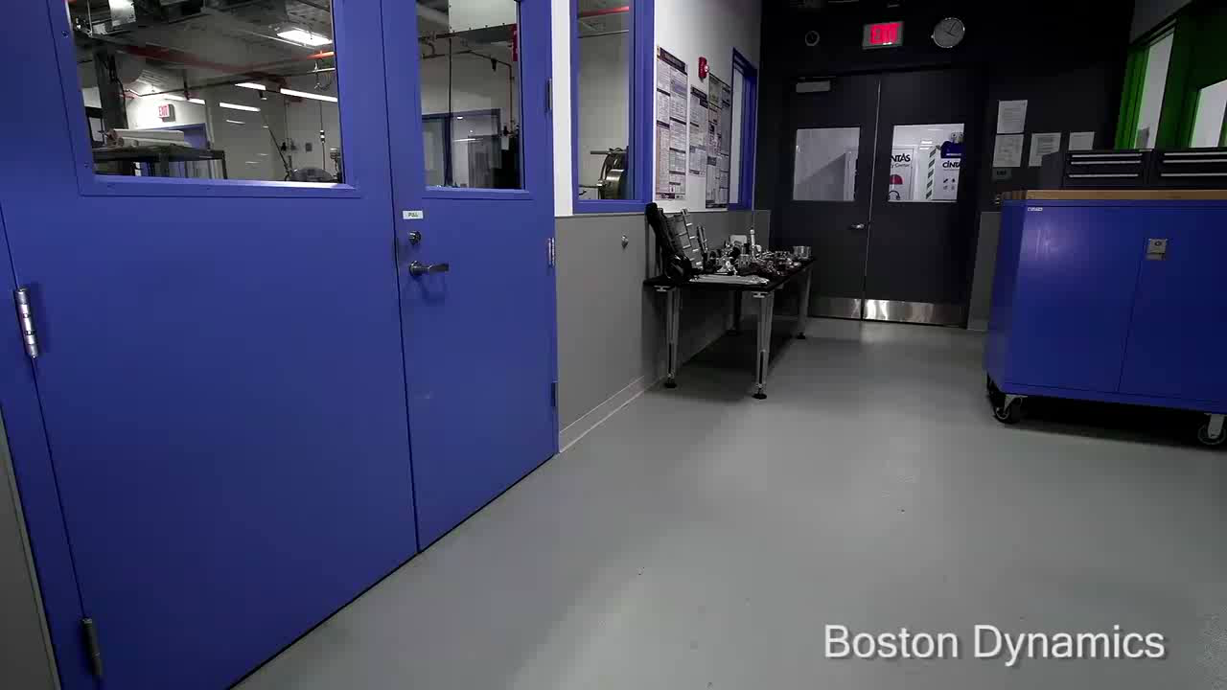
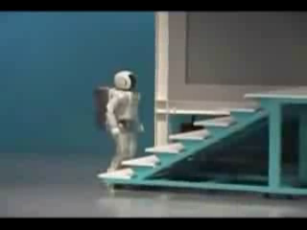
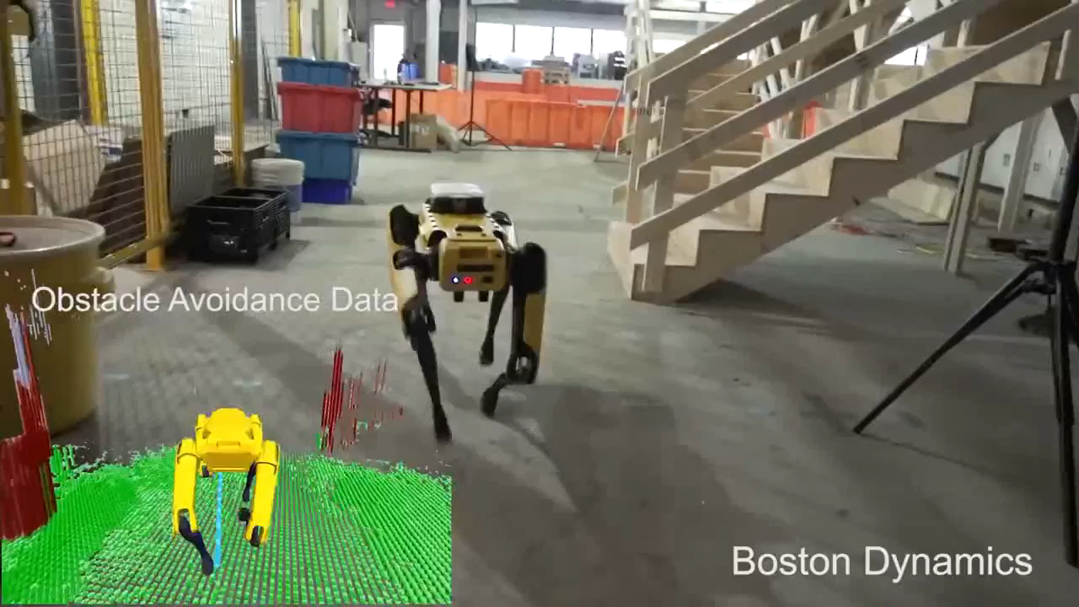
1. Background Explanation
Bipedal vs. Quadrupedal
- Stable
- Heavy payload
Recommendation: Quadrupedal
Notes:
Stable: 다리가 4개이므로 기본적으로 bipedal보다 안정적, 통신이 끊기거나 갑작스러운 전원 차단에도 로봇의 com이 support polygon 바깥으로 나갈 확률이 적음.

Slide 5
1. Background Explanation
∴ Quadrupedal Robot Reliable Motion Control
Highly related with “Civil Robotics”
Notes:
Stable: 다리가 4개이므로 기본적으로 bipedal보다 안정적, 통신이 끊기거나 갑작스러운 전원 차단에도 로봇의 com이 support polygon 바깥으로 나갈 확률이 적음.

Slide 6
1. Background Explanation
How Robot Works??
Notes:
로봇은 어떻게 움직이는가?

Slide 7
1. Background Explanation
Position based Robot
Torque based Robot

Slide 8
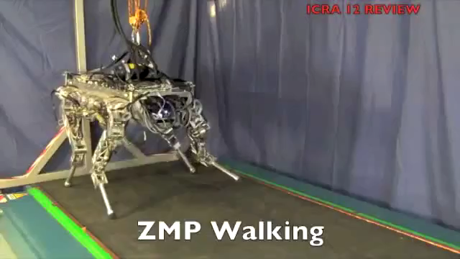
1. Background Explanation – Position based Robot
Control angle of each joint
Rigid and precise movement from high gain
Notes:
Position based control robot에 대한 소개
IIT HyQ version 1.2(2011)
Joint의 각도를 주로 control함.

Slide 9
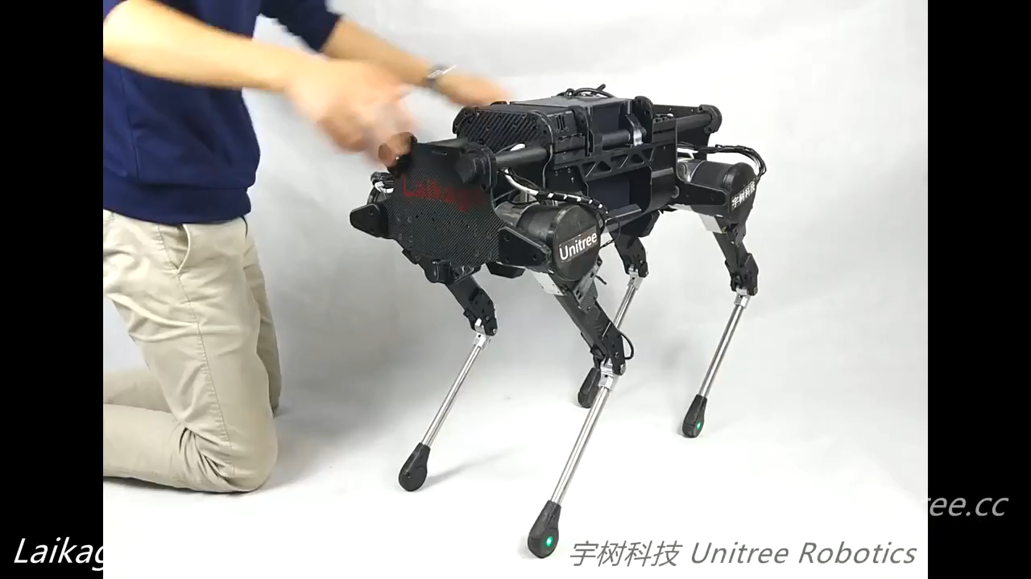
1. Background Explanation – Torque based Robot
Unitree Laikago
Control torque(current) of each joint
Notes:
Torque based control robot에 대한 소개
Joint의 토크를 주로 control함.
여담: Torque based control robot과 Position based control robot의 차이 및 Torque based control robot의 필요조건.
과거에 Torque based control robot이 흔하지 않았던 이유.

Slide 10

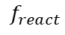
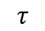
1. Background Explanation – Torque based Robot
Advantage of Torque control
Compliance
$$f_{react}$$
Obstacle
Obstacle
$$θ$$
$$τ$$
M
M
Torque based controlled robot
저감속비, 고토크 모터 필요
모터 기술의 발달 등으로 최근에 들어와 활성화

Slide 11
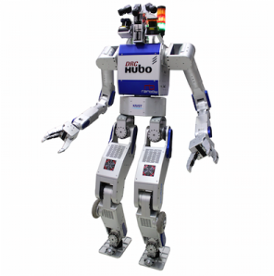
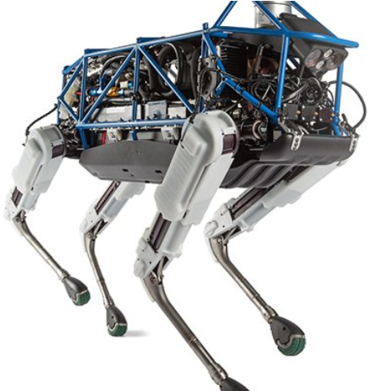
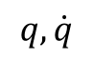
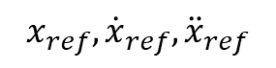
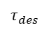
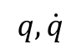
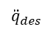
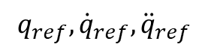
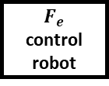
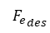
1. Background Explanation
General robot control framework
$$q, \dot{q}$$
High-level controller
$$x_{ref},{\dot{x}}_{ref},{\ddot{x}}_{ref}$$
$$q, \dot{q}$$
Low-level controller
$$q_{ref},{\dot{q}}_{ref},{\ddot{q}}_{ref}$$
Plant
$${\ddot{q}}_{des}$$
$$τ_{des}$$
$${F_{e}}_{des}$$
Position control robot
Torque
control robot
$$F_{e}$$
control robot
Notes:
전반적인(일반적인) 로봇 프레임워크 흐름에 대한 설명

Slide 12
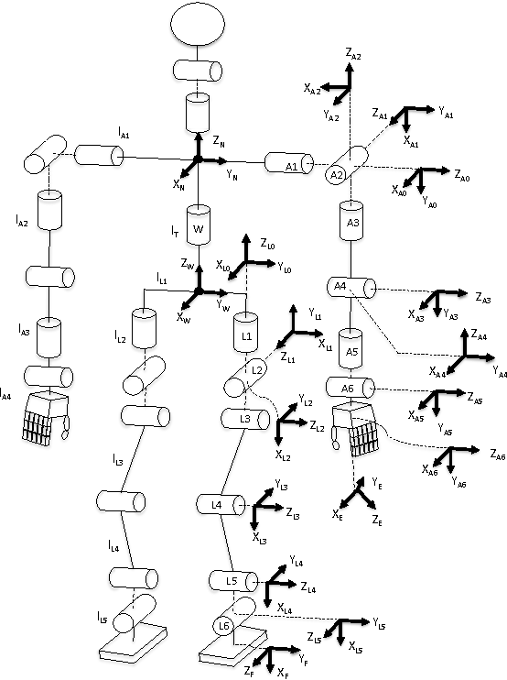
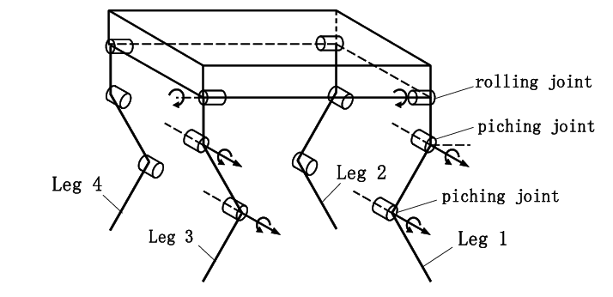
1. Background Explanation – Simplified Robot Model
Full Body Model
Too complicate!
Take long computation time
Use simplified model

Slide 13
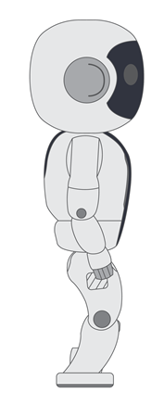

1. Background Explanation – Simplified Robot Model
Rigid Inverted Pendulum with Point Mass
Notes:
HLC의 종류

Slide 14
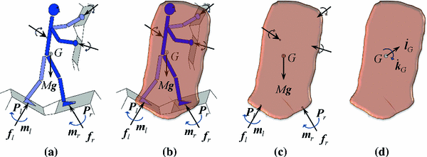
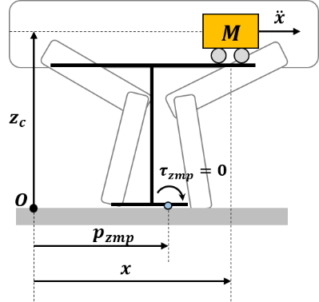
1. Background Explanation – Simplified Robot Model
Centroidal Dynamics Model
LIPM
Cart-Table Model
Full-Body Model
SLPM
Notes:
LIPM(Linear Inverted Pendulum Model)
SLPM(Spring Loaded Pendulum Model)
Centroidal Dynamics Model
Cart-Tabel Model
Full-Body Model

Slide 15
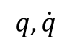
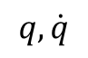
1. Background Explanation – High-Level Controller
$$q, \dot{q}$$
High-level controller
HLC(High-Level Controller): Construct robot reference trajectory from sensor/feedback data
$$q, \dot{q}$$
Low-level controller
ZMP(Zero Moment Point) based HLC
Plant
CP(Capture Point) based HLC
$${\ddot{q}}_{des}$$
$$τ_{des}$$
$${F_{e}}_{des}$$
Position control robot
Torque
control robot
$$F_{e}$$
control robot
Notes:
HLC의 종류

Slide 16
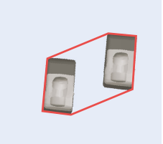
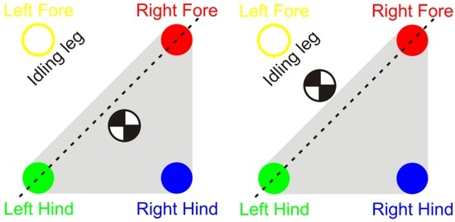
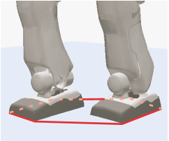
1. Background Explanation – Support Polygon
What is support polygon
Smallest convex set including all contact points
Notes:
The ground projection of CoM
Inside of the support polygon: stable

Slide 17
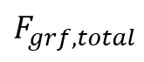
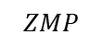
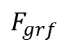
1. Background Explanation – ZMP
ZMP: Zero Moment Point
The ZMP always locates inside of the support polygon.
$$F_{grf,total}$$
ZMP represents candidate of foot placements
$$ZMP$$
$$F_{grf}$$

Slide 18
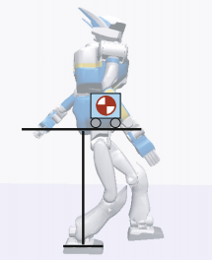
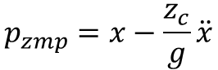
1. Background Explanation – ZMP based HLC
$$p_{zmp}=x−\frac{z_{c}}{g}\ddot{x}$$
Notes:
HRP의 사진
Cart-Table로 단순화 가능
이 경우 ZMP Equation은 다음과 같다.

Slide 19
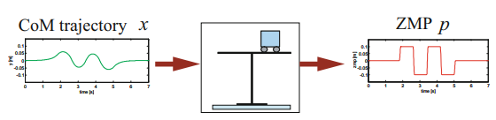
1. Background Explanation – ZMP based HLC
Depends on Robot model,
Specify target CoM motion
Calculate appropriate ZMP
Specify target ZMP motion
Calculate appropriate CoM

Slide 20
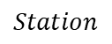
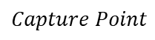
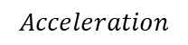
1. Background Explanation – High-Level Controller
What is Capture Point
CP can be decided from current CoM state
$$Station$$
$$Acceleration$$
Can modify CoM movement to adjust foot placement based on CP
$$Capture Point$$

Slide 21
1. Background Explanation – High-Level Controller
$$q, \dot{q}$$
High-level controller
LLC(Low-Level Controller): Calculate joint angle or joint torque set from the CoM reference
$$q, \dot{q}$$
Low-level controller
IK(Inverse Kinematics)
Plant
ID(Inverse Dynamics)
$${\ddot{q}}_{des}$$
$$τ_{des}$$
$${F_{e}}_{des}$$
Position control robot
Torque
control robot
$$F_{e}$$
control robot
Notes:
HLC의 종류

Slide 22
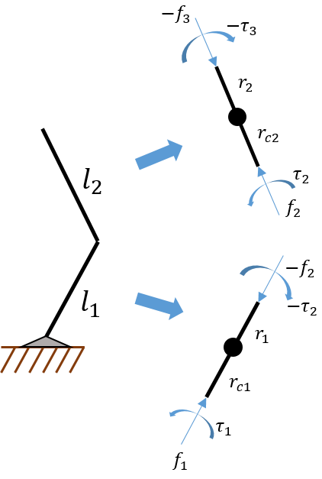
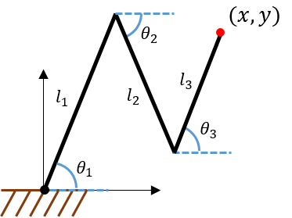
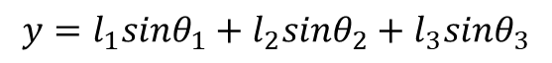
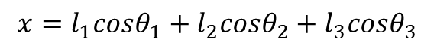
1. Background Explanation – High-Level Controller
IK(Inverse Kinematics)
ID(Inverse Dynamics)
$$x=l_{1}cosθ_{1}+l_{2}cosθ_{2}+l_{3}cosθ_{3}$$
$$y=l_{1}sinθ_{1}+l_{2}sinθ_{2}+l_{3}sinθ_{3}$$
Notes:
HLC의 종류

Slide 23
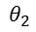
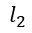
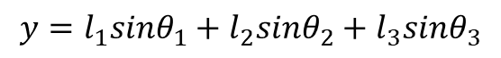
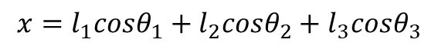
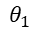
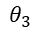

1. Background Explanation – Inverse Kinematics
$$(x,y)$$
$$θ_{2}$$
$$l_{1}$$
$$l_{2}$$
$$l_{3}$$
$$θ_{3}$$
$$θ_{1}$$
$$x=l_{1}cosθ_{1}+l_{2}cosθ_{2}+l_{3}cosθ_{3}$$
$$y=l_{1}sinθ_{1}+l_{2}sinθ_{2}+l_{3}sinθ_{3}$$
Notes:
HLC의 종류

Slide 24














1. Background Explanation – High-Level Controller
Newton`s Law: $\sum{F}=m{\ddot{x}}_{com}$
$${seg1: \overline{f_{1}}−\overline{f_{2}}=m_{1}\dot{\overline{v_{1,c}}} \atop seg2: \overline{f_{2}}−\overline{f_{3}}=m_{2}\dot{\overline{v_{2,c}}}}$$
$$−f_{3}$$
$$−τ_{3}$$
$$r_{2}$$
$$r_{c2}$$
$$l_{2}$$
$$τ_{2}$$
Newton`s Law: $\sum{T_{com}}=I_{com}\ddot{θ}$
$${seg1: \overline{f_{1}}−\overline{f_{2}}=m_{1}\dot{\overline{v_{1,c}}} \atop seg2: \overline{f_{2}}−\overline{f_{3}}=m_{2}\dot{\overline{v_{2,c}}}}$$
$$f_{2}$$
$$−f_{2}$$
$$l_{1}$$
$$−τ_{2}$$
$$r_{1}$$
$$r_{c1}$$
$$τ_{1}$$
$$f_{1}$$

